Slide 1



Welcome to Intro to DOM!
We will begin shortly.
As you’re coming in…
Please have your camera on, if possible and change your name on Zoom to include your pronouns
Drop into the Zoom chat: what’s a controversial food opinion that you have?

Slide 2
Agenda:
<5 min> Opening
<20 min> From the Padlet
<15 min> Quick Review
<15 min> Sharing Our Event Listener Starter Code
<5 min> Break
<40 min> Beginning Our To-Do List
<10 min> Adding Functionality to our To-Do List
<10 min> Close-Out

Slide 3
As a quick note!
If you need Hannah’s help at any point, feel free to DM her and/or head into a breakout room!

Slide 4
From the Padlet
Notes:
⭐️ ⭐️ ⭐️ ⭐️ ⭐️ ⭐️ ROUND 1 ⭐️ ⭐️ ⭐️ ⭐️ ⭐️ ⭐️

Slide 5
Any best practices or rules for working in replit?

Slide 6
Fancy event-listeners

Slide 7
Building on what we covered today
What more can be done with JS in the DOM (Lori)
Building on what we covered today (Gillian)
How to do fancier (more complex) DOM changes (Kat)

Slide 8
Quick Review
Notes:
⭐️ ⭐️ ⭐️ ⭐️ ⭐️ ⭐️ ROUND 1 ⭐️ ⭐️ ⭐️ ⭐️ ⭐️ ⭐️

Slide 9
Round 1: What does DOM stand for?

Slide 10
Round 1: What does DOM stand for? DOCUMENT OBJECT MODEL
Notes:
⭐️ ⭐️ ⭐️ ⭐️ ⭐️ ⭐️ ROUND 2 ⭐️ ⭐️ ⭐️ ⭐️ ⭐️ ⭐️

Slide 11
Round 2: T or F, when we manipulated the DOM, we edited that HTML page permanently.

Slide 12
Round 2: T or F, when we manipulated the DOM, we edited that HTML page permanently. False.
Notes:
⭐️ ⭐️ ⭐️ ⭐️ ⭐️ ⭐️ ROUND 3 ⭐️ ⭐️ ⭐️ ⭐️ ⭐️ ⭐️

Slide 13
Round 3: What would I type into the blank to access this element by Id?
document.____________(‘this-is-an-id’)

Slide 14
Round 3: What would I type into the blank to access this element by Id?
document.getElementById(‘this-is-an-id’)
Notes:
⭐️ ⭐️ ⭐️ ⭐️ ⭐️ ⭐️ ROUND 4 ⭐️ ⭐️ ⭐️ ⭐️ ⭐️ ⭐️

Slide 15
Round 4: Is getElementById a method or a property?

Slide 16
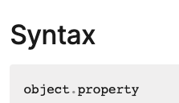
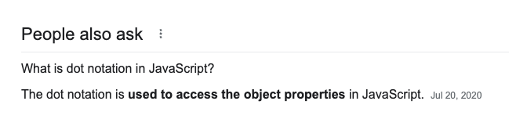
Round 4: Is getElementById a method or a property? Property.
Notes:
⭐️ ⭐️ ⭐️ ⭐️ ⭐️ ⭐️ ROUND 5 ⭐️ ⭐️ ⭐️ ⭐️ ⭐️ ⭐️

Slide 17
Round 5: Which one is preferable: event handlers or event listeners?

Slide 18
Round 5: Which one is preferable: event handlers or event listeners? Event listeners.

Slide 19
Well done everyone! 👏

Slide 20
Sharing Our Event Listener Starter Code

Slide 21
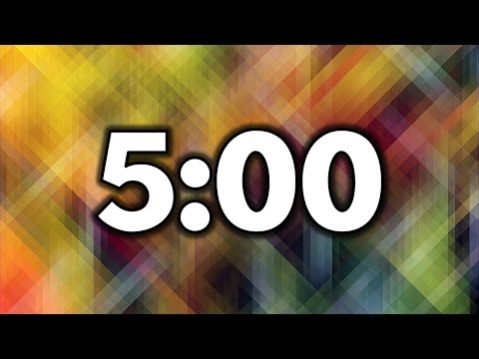
You did it!
🎉
Now it’s your turn
Using what we just did as starter code, you have three options:
OPTION 1: Change the event listener
OPTION 2: Change the outcome
OPTION 3: BOTH!
Check out the resources available at the Links & Resources for inspiration!
Please head to the Links & Resources and add your slide to the Intro to DOM Starters Slide Deck
Notes:
Hannah: please make random breakout rooms so that there are 3-4 people in each for Slide 22

Slide 22
Breakout Rooms
<12 minutes> Groups of 3-4
~ 3 minutes per person
Share your output/website via sharing your screen
Share your code
Share about the process
What resources did you use?
What was a challenge that you overcame?
What did you learn?
What are you still curious about?
Answer any questions that other people in the group may have!
Notes:
<12 minutes> Groups of 3-4
~ 3 minutes per person
Share your output/website
Share your code
Share about the process
What resources did you use?
What was a challenge that you overcame?
What did you learn?
What are you still curious about?
Answer any questions that other people in the group may have!

Slide 23
Break

Slide 24
Beginning Our To-Do List

Slide 25
Your Task
Build a to-do list using HTML, CSS, and JavaScript.
Your To-Do list will include:
A space to type a to-do
Add the item to an ongoing list
Mark an item as complete

Slide 26
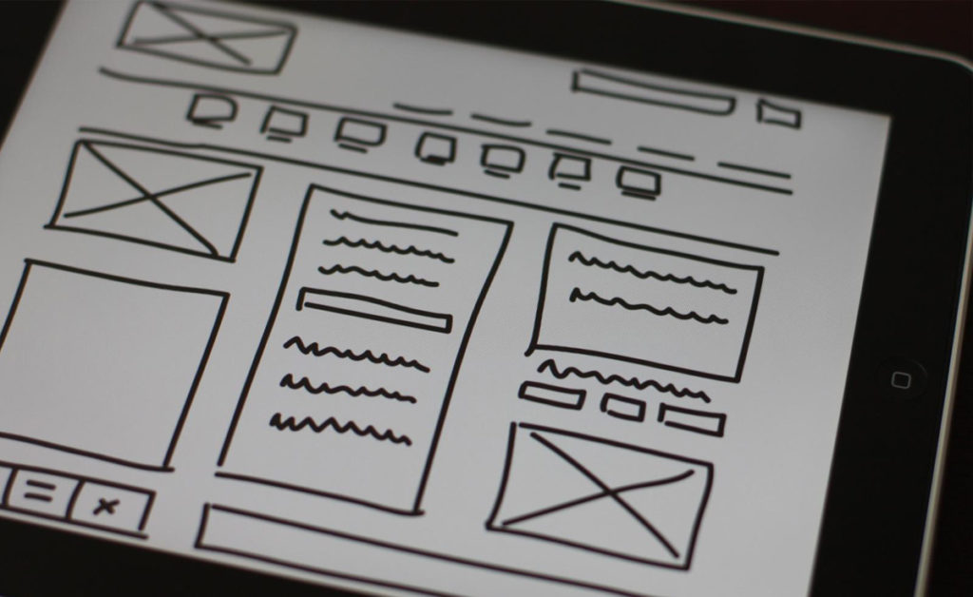
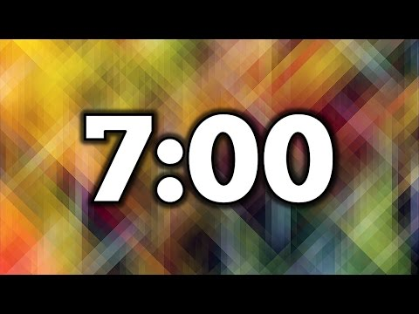
First Step: Wireframe!
Take 7 minutes and wireframe what your To-Do List website would look like.
Notes:
Hannah: please make random breakout rooms so that there are 3-4 people in each for Slide 27

Slide 27
Breakout Rooms
<3 minutes> In groups of 3-4, share your wireframe!
Notes:
<3 minutes> In groups of 3-4, share your wireframe!

Slide 28
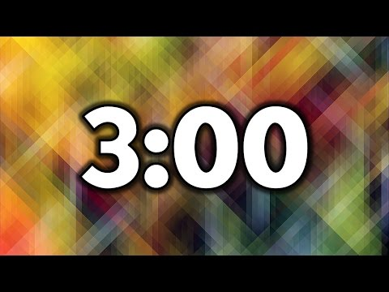
Second Step: Begin coding the HTML & CSS of your to-do list
You’re going to begin coding the HTML & CSS of your to-do list
Some elements that you may want to consider adding:
Form
Input
Div
Button
Each room will have a different working style:
Main Room: I’m good to go, I can code this on my own and will collaborate with others in the main room.
Breakout Room 1 with Tara: Let’s code-along a to-do list together (in a bit)!
Breakout Room 2 with Hannah: Stop by if you have any specific questions
Notes:
Hannah: please create 3 breakout rooms
Tara to drop into chat:
Main Room: I’m good to go, I can code this on my own and would like to do it silently !
Breakout Room 1: I’d like to mostly code on my own, but I’ll work with others if needed!
Breakout Room 2 with Tara: Let’s code-along a to-do list together!
Breakout Room 3 with Hannah: Stop by if you have any specific questions

Slide 29
Closing Out

Slide 30
Course Sequence
Day 1 - Tuesday
Introduction to the course
Introduction to DOM
Learning about DOM events and event listeners
Using browser (Chrome/Firefox) Developer Tools
Wireframing and coding the HTML & CSS of a to-do list app
Day 2 - Wednesday
Responding to user interactions on our web pages
Adding elements to the DOM to create a to-do list app
Day 3 - Friday
Querying and updating a page after it’s loaded
Adding finishing touches to our to-do list app
Final presentations
✅
✅

Slide 31
End of Class Survey
Notes:
🔗 End of class survey: https://forms.gle/AWAGrJP5xPxysiEc7

Slide 32
Round Robin Closeout
Please put your camera on if you’d like to participate!
Answer one of the following questions:
What is something you learned today in class?
How are you feeling and why?
What are you most proud of yourself for?
What are you still curious about?
Popcorn to someone else!
Turn your camera off so we know you’ve already gone.
Notes:
🔗 Please head to this Padlet and answer the questions: https://padlet.com/taratptran/domsession1

Slide 33
Next Steps
Fill out the end of class survey: https://forms.gle/AWAGrJP5xPxysiEc7
Continue working on your HTML and CSS of your To-Do List App
Email Tara or Hannah if you have any questions!
Notes:
🔗 End of class survey: https://forms.gle/AWAGrJP5xPxysiEc7

